Slide 1

Acute Severe Colitis: timing, teamwork and turning points
Fabiana Castiglione
Department of Clinical Medicine and Surgery
University Federico II of Naples

Slide 2
Acute Severe Colitis: a day-by-day process…
ASUC usually presents as acute episodes of a relapsing-remittent UC
ASUC may be the onset feature in up of one-third of UC patients
Although colectomy rates for ASUC have fallen over time, they remain disappointingly high at 10%–15%
ASUC continues to carry a mortality risk of 1%
Around 25% UC patients have at least one ASUC episode during their disease course
higher in older patients and in those undergoing emergent colectomy
Riviere P, Lancet Gastroenterol Hep 2024
Spinelli A, JCC 2022

Slide 3
Timing
Hospital
Setting
Diagnosis
Therapy
Teamwork
Clinical
Surgical
Turning points
Assessment Evaluation
Acute Severe Colitis: a day-by-day process…
AT
ANY
STAGE
Riviere P, Lancet Gastroenterol Hep 2024
Spinelli A, JCC 2022

Slide 4
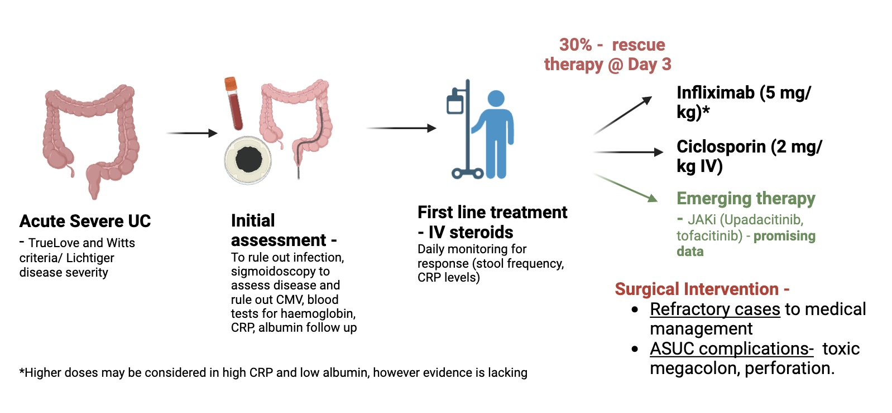

Let’s begin our speech
TIME
No wait to include surgery into therapeutic options
Moran GW, Gut. 2025

Slide 5
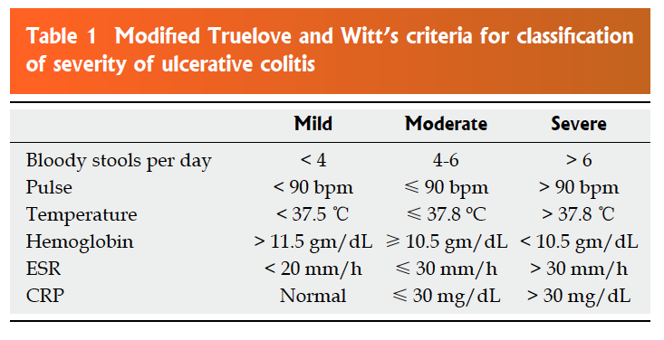
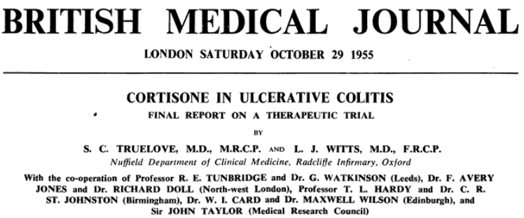
Diagnosis
Once upon a time…and nowdays still
Teamworker: General Practitioner; Emergency Room
Mild: all 6 criteria are satisfied
Moderate: Intermediate between mild and severe.
Severe: criteria 1 and 2 and either of systemic symptoms 3 and 4 are satisfied, and at least 4 of 6 criteria are present
Truelove SC, Br Med J 1955
Stange EF, JCC 2008

Slide 6
At hospital admission
Diagnosis
Hospital setting
Points to manage | Method | Limitations
Swift diagnosis to decrease colectomy rates | Truelove and Witts or Lichtiger score, lab tests (CRP, Hemoglobin, albumin) | Clinician extensive evaluation should also be performed
Identify triggering factors | Medical history (current or past digestive infections), treatment history (NSAIDS) | Systematic use of antibiotics does not decrease colectomy rates,
Identify worsening factors including C. difficile and CMV | Stool culture and PCR for toxin Colonic biopsies and immunohistochemistry for CMV | Treatment of infection only is most of the time insufficient
Assess endoscopic severity | UCEIS>Mayo Deep ulcers | Inter‐investigator agreement is moderate
Imaging for abscesses, colectasia, perforation | CT-scan | Consider US to avoid radiation
Manage thromboembolism risk | LMWH | Optimal duration requires further investigation
Optimize nutritional status | Nutritional assessment including caloric input and iron levels | Exclusive enteral nutrition may be used to improve early outcomes but with limited acceptability
For all patients, early assessment of treatment eligibility through biology, viral and tuberculosis screening.
Teamworker: Emergency Room; Nursing; Radiologist; Endoscopist; Pathologist; IBDologist
Calméjane L, United European Gastroenterol J. 2023

Slide 7
Intravenous steroid (IV) therapy and first-line therapy
Therapies
MORTALITY IN SEVERE ATTACKS OF UC
Therapy on admission
Early IV steroids: At least 0.8 mg/kg for a maximum duration of 7 days (consider surgery if no response at 3 and 5 days)
Low molecular weight heparin prophylaxis: Enoxaparin 40 mg daily
Consider antibiotics if specific context including fever
Consider exclusive enteral nutrition
24%
% MORTALITY
7%
< 1%
Calméjane L, United European Gastroenterol J. 2023
Jakobovitz, Br Med Bull 2006
Truelove, BMJ 1955

Slide 8
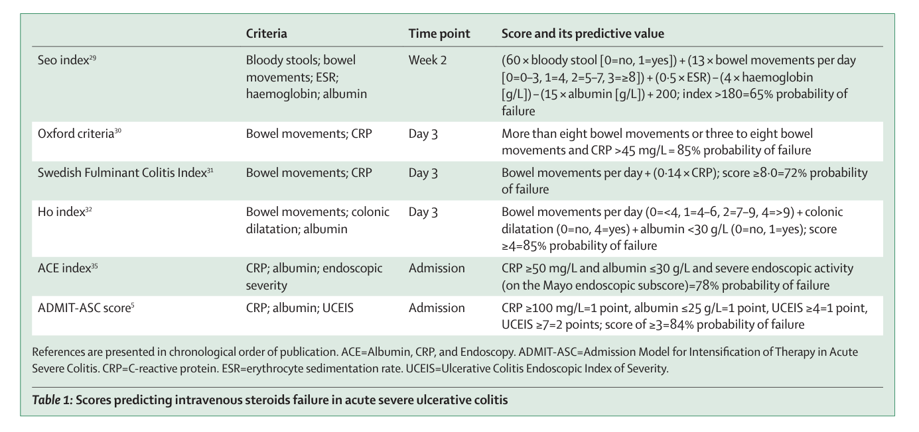
Scores Predicting IV steroids failure in ASUC
For use in clinical practice, the Oxford criteria is the best validated predictive score for determining intravenous steroids failure at 3 days of treatment
The ADMIT-ASC score, which is able to predict steroid failure at admission, needs further confirmation
Riviere P, Lancet Gastroenterol Hep 2024
Notes:
ADMIT (admission)- ASC (acute severe colitis) score 2022 (…Travis)

Slide 9
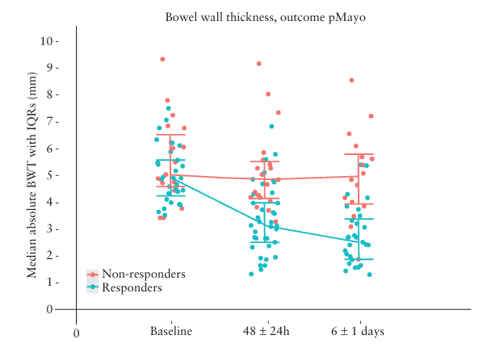
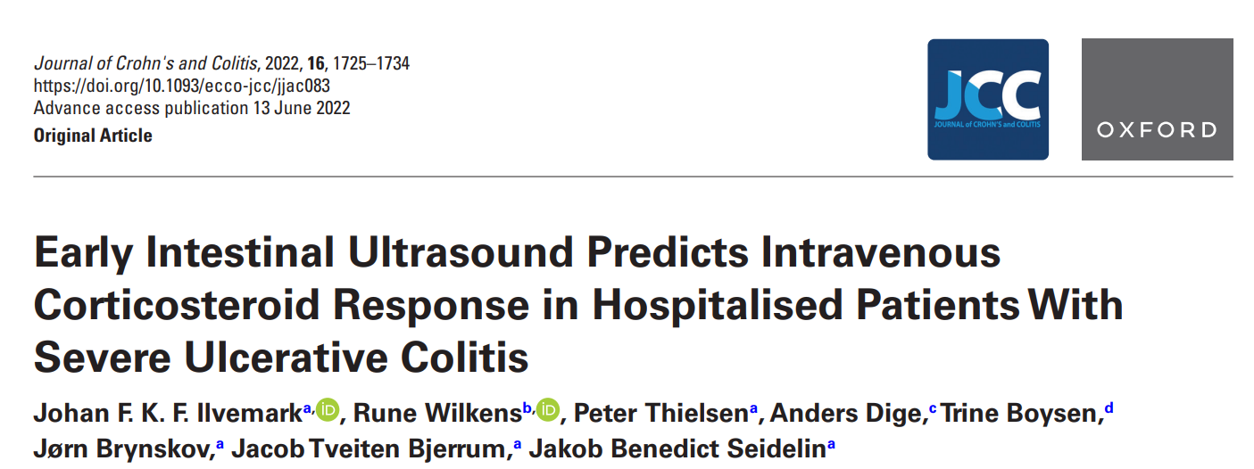
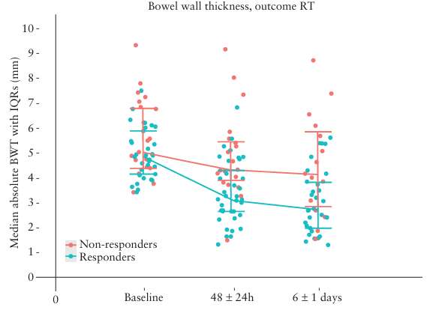
Prognostic imaging: bowel ultrasound
Changes in bowel wall thickness, after 48 ± 24 h following intravenous corticosteroid treatment identify responders with high accuracy and might be used as an early marker to guide accelerated rescue therapy
Ilvemark JFKF, J Crohns Colitis. 2022
Notes:
Background and Aims: Our aim was to determine if transabdominal intestinal ultrasound changes after 48 ± 24 h of intravenous corticosteroids can predict treatment outcomes in hospitalised patients with severe ulcerative colitis.
Methods: We performed a blinded observational multicentre study. Ultrasound parameters were assessed before treatment initiation, after 48 ± 24 h, and 6 ± 1 days. Treatment response was determined within 7 days by two outcome measures: 1] partial Mayo score reduction; 2] no administration of rescue therapy.
Results: Out of 69 recruited patients, 56 were included in the final analysis, with 37 responders. The colon segment with the highest base line bowel wall thickness was analysed, being the sigmoid in all patients. There was no difference in baseline bowel wall thickness between responders and non-responders in the partial Mayo score outcome. At 48 ± 24 h, a significant difference between responders and non responders was identified in both absolute bowel wall thickness [median 3.1 mm vs 4.9 mm; p 20% reduction had the highest odds ratio (22.6 [4.2, 201.2]; p = 0.001) for determining response. Similar results were seen for the rescue therapy outcome. Conclusions: Changes in bowel wall thickness, after 48 ± 24 h following intravenous corticosteroid treatment in hospitalised patients with severe ulcerative colitis, identify responders with high accuracy and might be used as an early marker to guide accelerated rescue therapy.

Slide 10
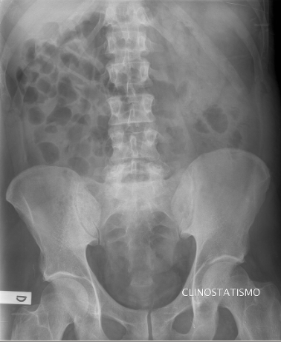
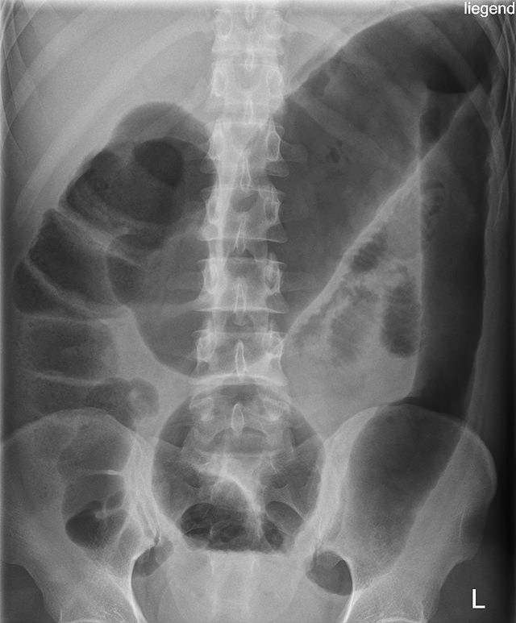
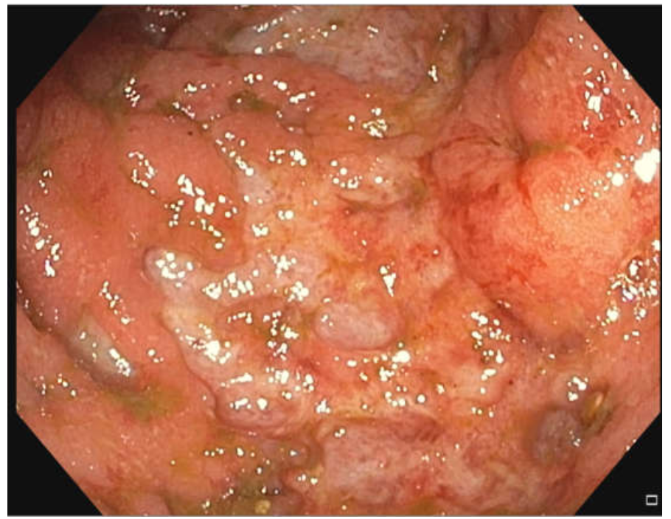
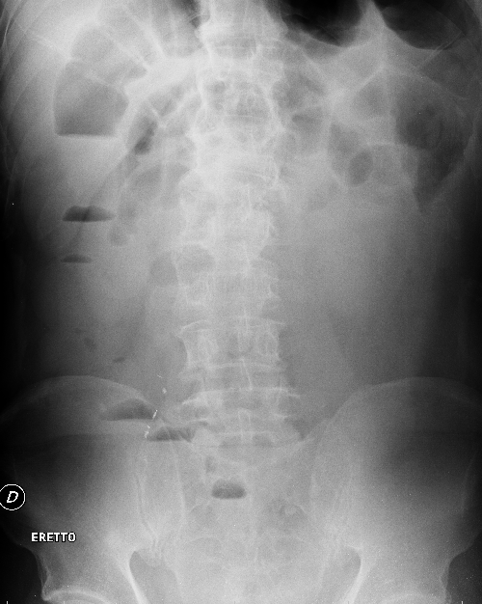
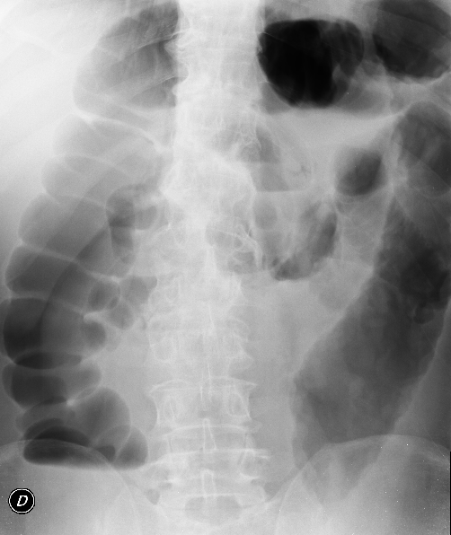
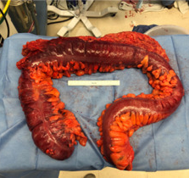
Prognostic imaging: radiology
FROM
INSIDE
OUT
Jakobovits SL, Br Med Bull. 2006
Latella G, Am J Gastroenterol 2002

Slide 11
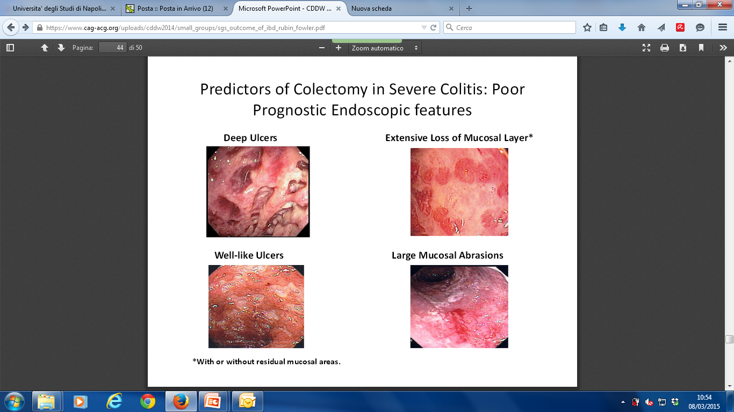
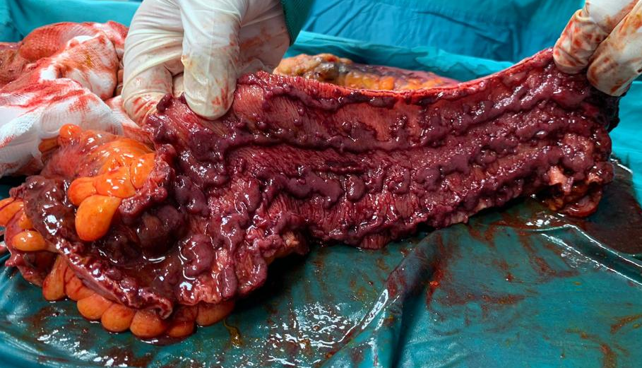
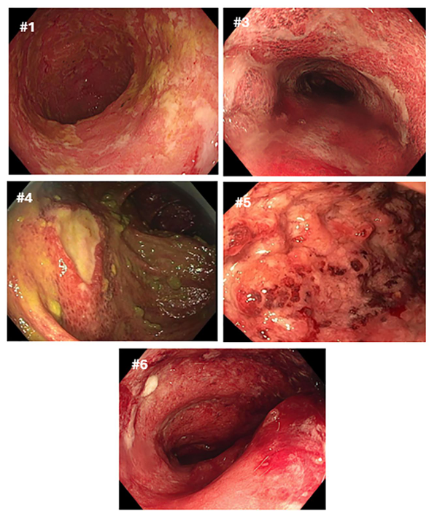
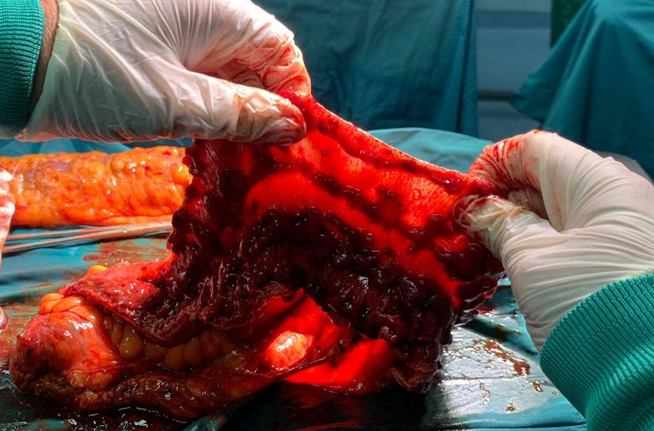
Prognostic imaging: Endoscopy
FROM
INSIDE
OUT
Carbonnel F, Dig Dis Sci. 1994
Etchegaray A, Ther Adv Gastr 2025
Surgery clips courtesy of Luigi Bucci and Gaetano Luglio
Notes:
Well-like ulcers =ulcere a pozzo
Nello studio di Carbonnel 46 su 85 pz con CU avevano una colite grave con ulcere profonde ed estese e 43/46 necessitarono di colectomia
Studi successivi hanno confermato che la presenza di lesioni endoscopiche gravi come le ulcere a pozzo è correlata ad un aumento del rischio di fallimento della terapia medica e di colectomia. Pertanto l’endoscopia consente la stratificazione del rischio

Slide 12
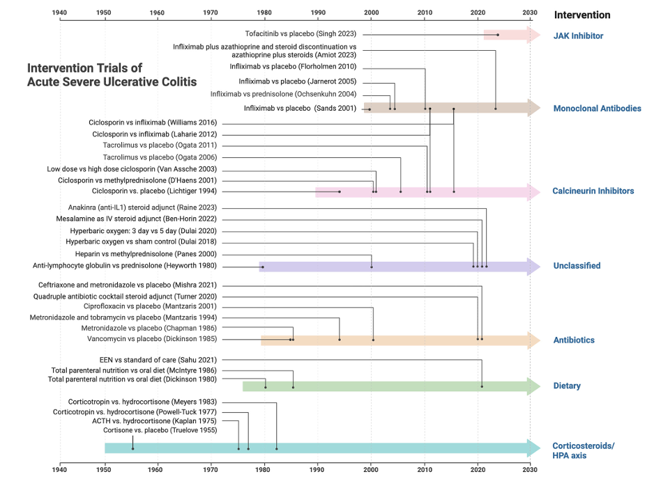
What next after steroids?
Honap S, Gut. 2024

Slide 13
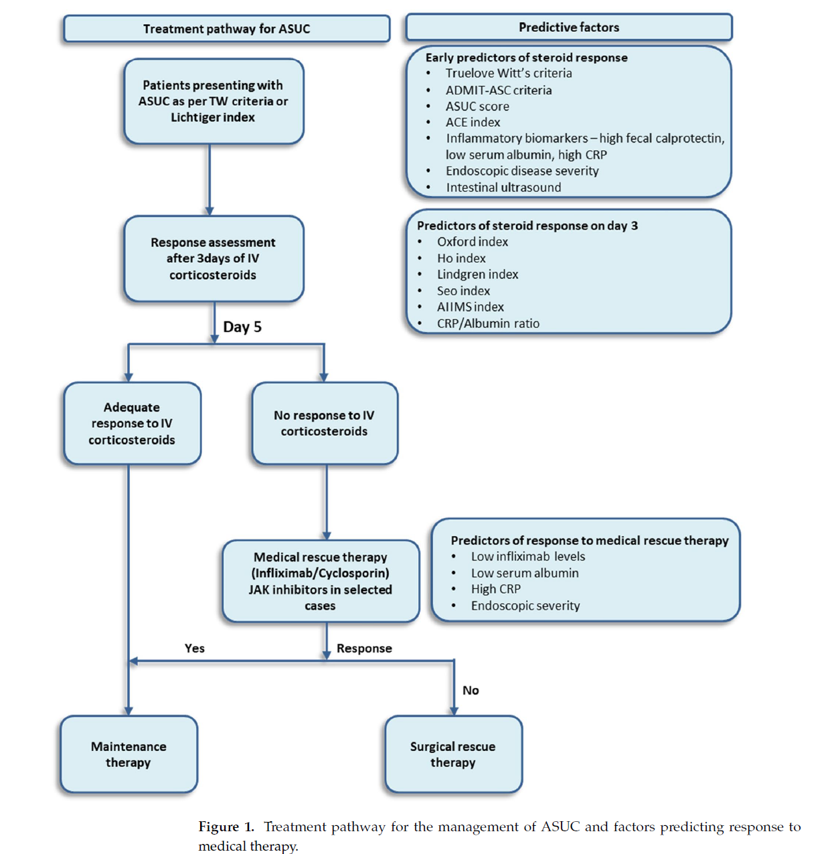
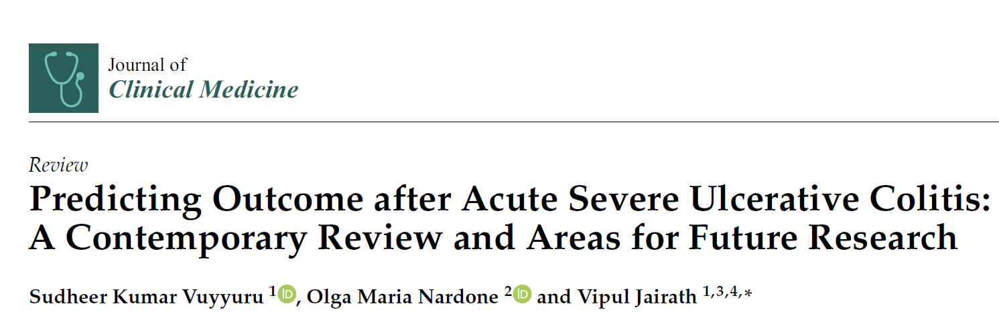
What next after steroids?
In patients steroid-refractory, calcineurin inhibitors and infliximab are used as rescue therapy

Slide 14
IFX as rescue therapy for severe UC
p= 0.017
(14/21)
% of patients
(7/24)
Jarnerot G, Gastroenterology 2005

Slide 15
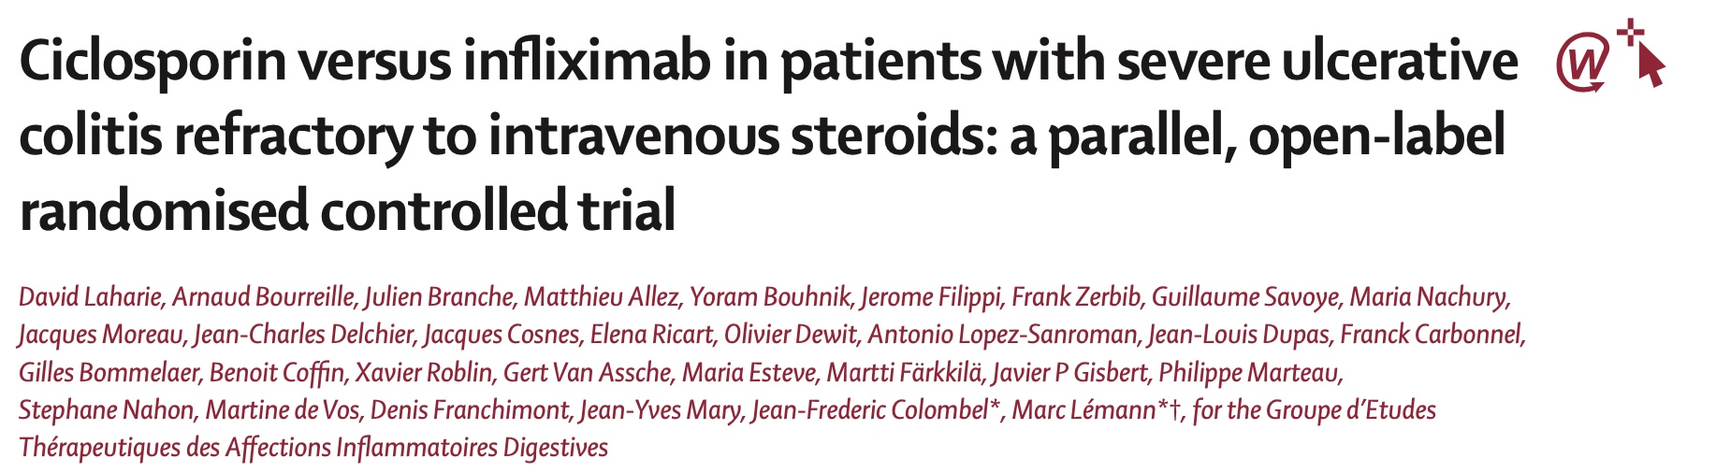
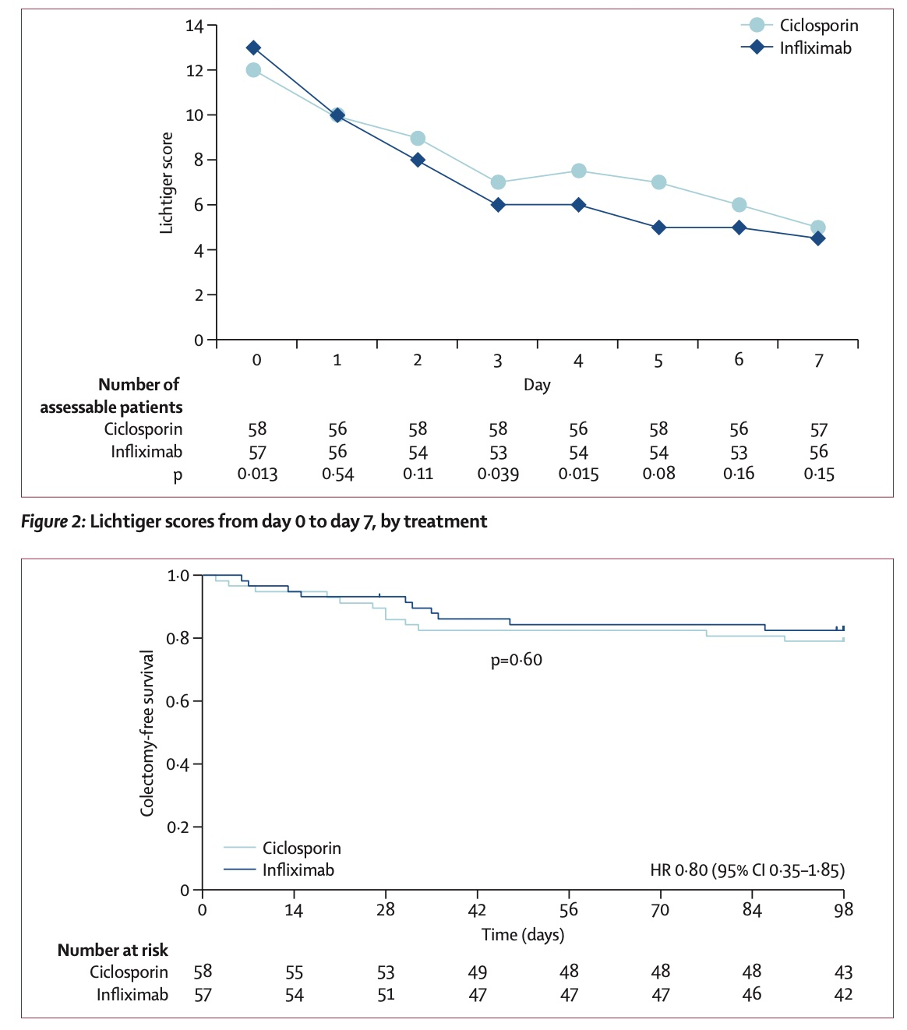
Laharie D, Lancet 2012
Notes:
Background: Ciclosporin and infliximab are potential rescue treatments to avoid colectomy in patients with acute severe ulcerative colitis refractory to intravenous corticosteroids. We compared the efficacy and safety of these drugs for this indication.
Methods: In this parallel, open-label, randomised controlled trial, patients were aged at least 18 years, had an acute severe flare of ulcerative colitis defined by a Lichtiger score greater than 10 points, and had been given an unsuccessful course of high-dose intravenous steroids. None of the patients had previously received ciclosporin or infliximab. Between June 1, 2007, and Aug 31, 2010, patients at 27 European centres were randomly assigned (via computer-derived permutation tables; 1:1) to receive either intravenous ciclosporin (2 mg/kg per day for 1 week, followed by oral drug until day 98) or infliximab (5 mg/kg on days 0, 14, and 42). In both groups, azathioprine was started at day 7 in patients with a clinical response. Neither patients nor investigators were masked to study treatment. The primary efficacy outcome was treatment failure defined by absence of a clinical response at day 7, a relapse between day 7 and day 98, absence of steroid-free remission at day 98, a severe adverse event leading to treatment interruption, colectomy, or death. Analysis was by intention to treat. This trial is registered with EudraCT (2006-005299-42) and ClinicalTrials.gov (NCT00542152).
Findings: 115 patients were randomly assigned; 58 patients were allocated to receive ciclosporin and 57 to receive infliximab. Treatment failure occurred in 35 (60%) patients given ciclosporin and 31 (54%) given infliximab (absolute risk difference 6%; 95% CI -7 to 19; p=0·52). Nine (16%) patients in the ciclosporin group and 14 (25%) in the infliximab group had severe adverse events.
Interpretation: Ciclosporin was not more effective than infliximab in patients with acute severe ulcerative colitis refractory to intravenous steroids. In clinical practice, treatment choice should be guided by physician and centre experience.

Slide 16
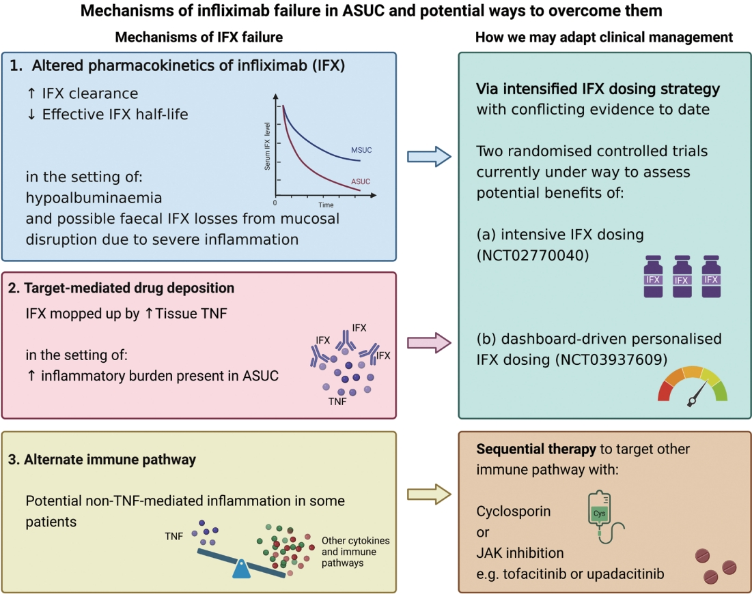
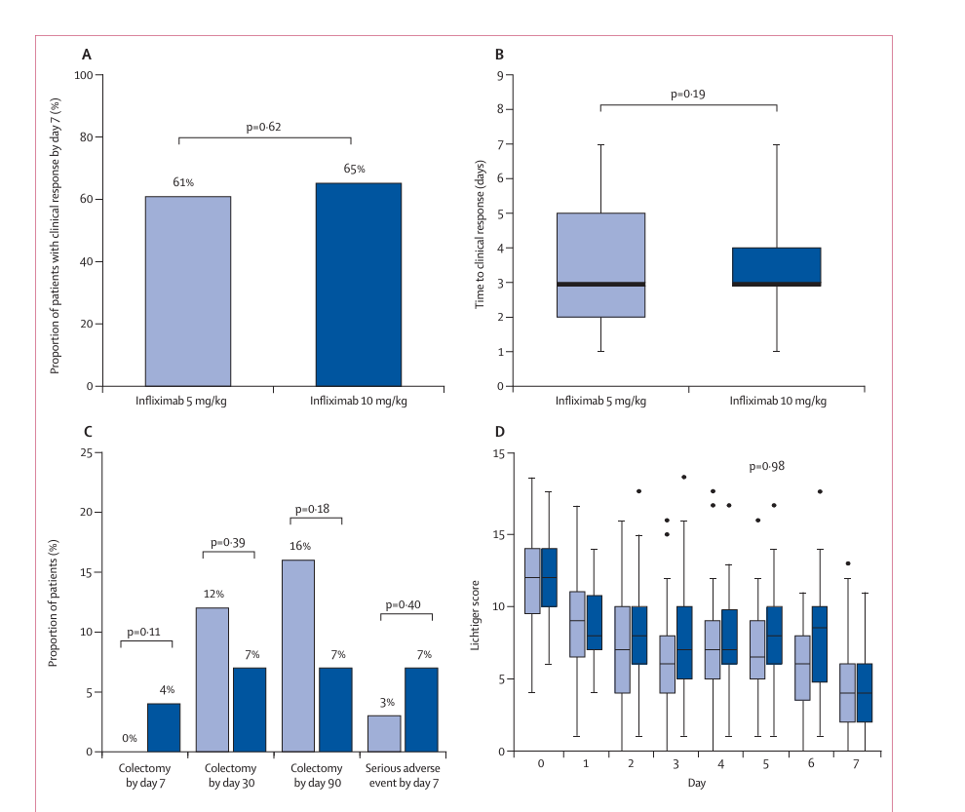
IFX Failure
In steroid-refractory ASUC, a first dose of 10 mg/kg IFX was not superior to 5 mg/kg in achieving clinical response by day 7 (PREDICT-UC)
Intensified, accelerated regimen did not result in a significant difference in clinical response by or in remission or colectomy rates
Vuyyuru SK, Clin Gastroenterol Hepatol 2025
Matthew C Choy, Lancet Gastro Hepato 2024
Notes:
faecal infliximab loss has been demonstrated to occur in ASUC
Primary outcomes were colectomy rate at discharge and at 3 and 12 months (perciò non include lo studio di Laharie)
Medical Therapy for Acute Severe Ulcerative Colitis: A Systematic Review With Meta-analysis
Sudheer K Vuyyuru ¹, Nader Shaban ², Yuhong Yuan ³, Sailish Honap ⁴, Lotus Alphonsus ⁵, Theshani Amalka De Silva ⁵, Abdulaziz Alajmi ², John K MacDonald ⁶, Christopher Ma ⁷, Parambir S Dulai ⁸, Laurent Peyrin Biroulet ⁹, Vipul Jairath ¹⁰
Background & aims: Acute severe ulcerative colitis (ASUC) is a medical emergency associated with high morbidity and mortality. We aimed to assess the efficacy and safety of medical treatments for ASUC.
Methods: MEDLINE, EMBASE, and CENTRAL were searched to November 14, 2024 for randomized controlled trials (placebo or active comparator), and comparative cohort studies that evaluated medical therapies for hospitalized adults with ASUC. Primary outcomes were colectomy rate at discharge and at 3 and 12 months. Safety outcomes included adverse events, serious adverse events, and infections. Pooled risk ratios (RR) and 95% confidence intervals (CI) were calculated.
Results: Forty-four studies (18 randomized controlled trials, and 26 cohort studies) assessing 22 different comparisons were included. Low certainty evidence suggests that infliximab (IFX) was significantly superior to cyclosporine A for reducing the risk of colectomy at discharge (RR, 0.56; 95% CI, 0.38-0.81; I² = 30%), 3 months (RR, 0.67; 95% CI, 0.48-0.92; I² = 36%), and 12 months (RR, 0.56; 95% CI, 0.42-0.75; I² = 46%). IFX patients were significantly more likely than cyclosporine A patients to develop an infection (RR, 2.38; 95% CI, 1.27-4.47; I² = 15%). There was no significant difference between accelerated and standard dosing regimens of IFX for colectomy at discharge or at 3 months. Tofacitinib in combination with intravenous corticosteroids was significantly superior to intravenous corticosteroids alone for induction of clinical response at Day 7; however, there was no difference in colectomy rate or infections at 3 months.
Conclusions: IFX may be more efficacious than cyclosporine A for the treatment of ASUC. Janus kinase inhibitors are promising treatment options in select individuals. Future studies should explore the efficacy of other advanced therapies.

Slide 17
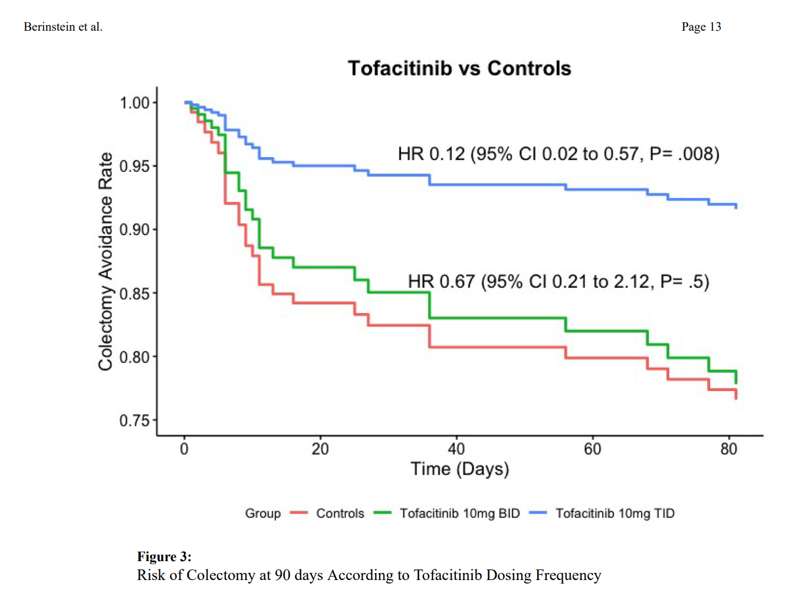
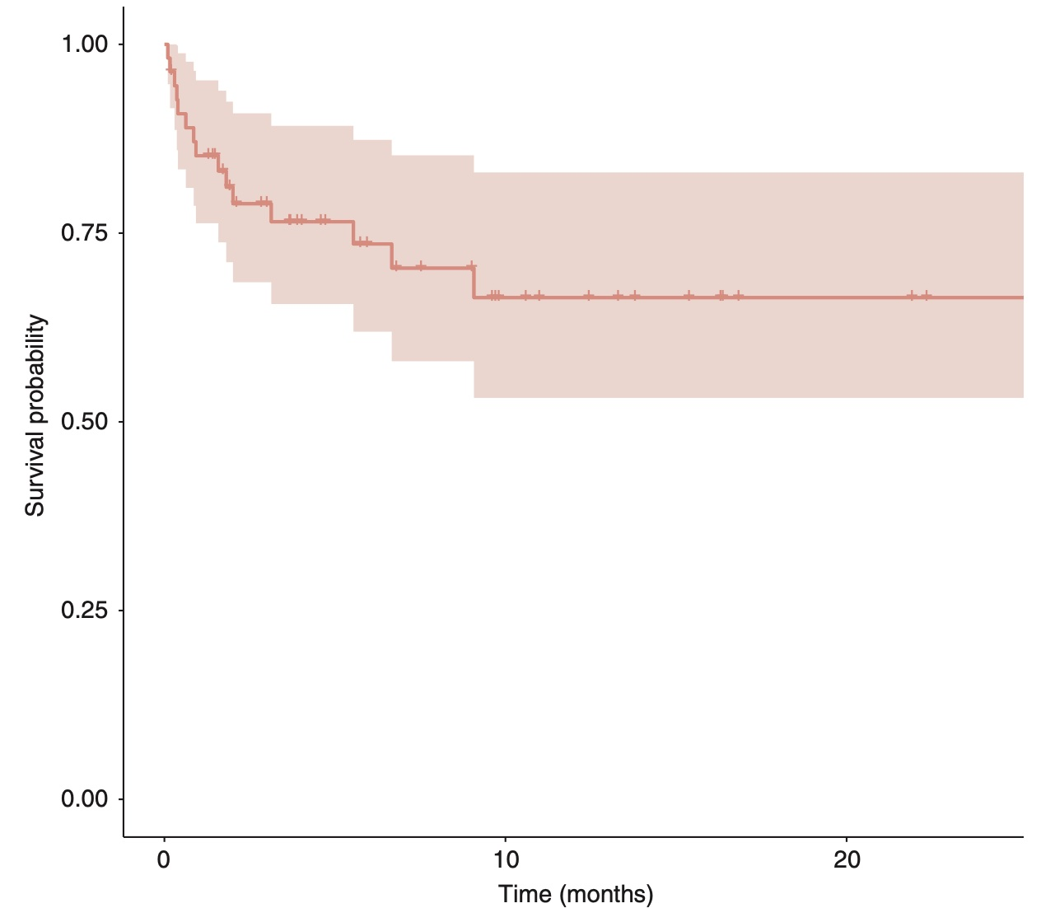
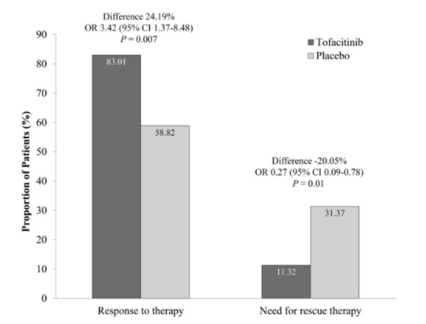
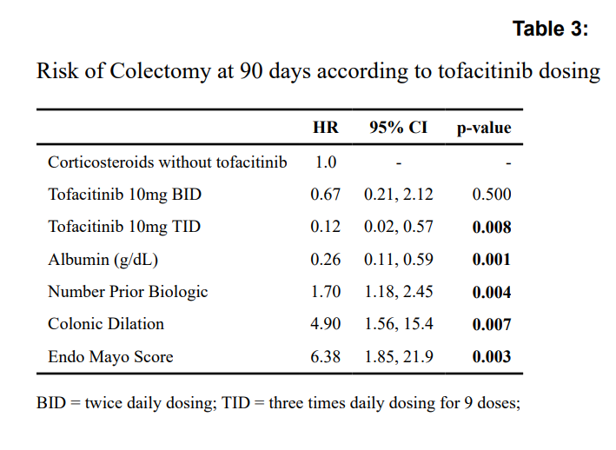
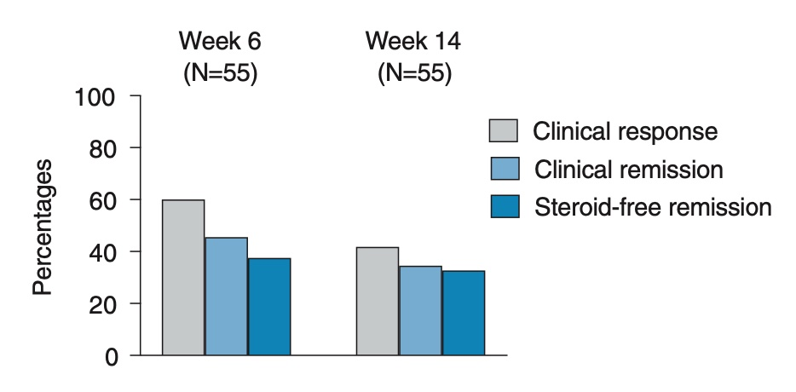
Rescue therapy: tofacitinib
+ steroids
+/- steroids
Observational study
case-control study
Randomized controlled trial
Uzzan M, Aliment Pharmacol Ther 2021
Berinstein JA, Clin Gastroenterol Hepatol 2021
Singh A, Am J Gastroenterol 2024
LEVEL
OF
EVIDENCE

Slide 18
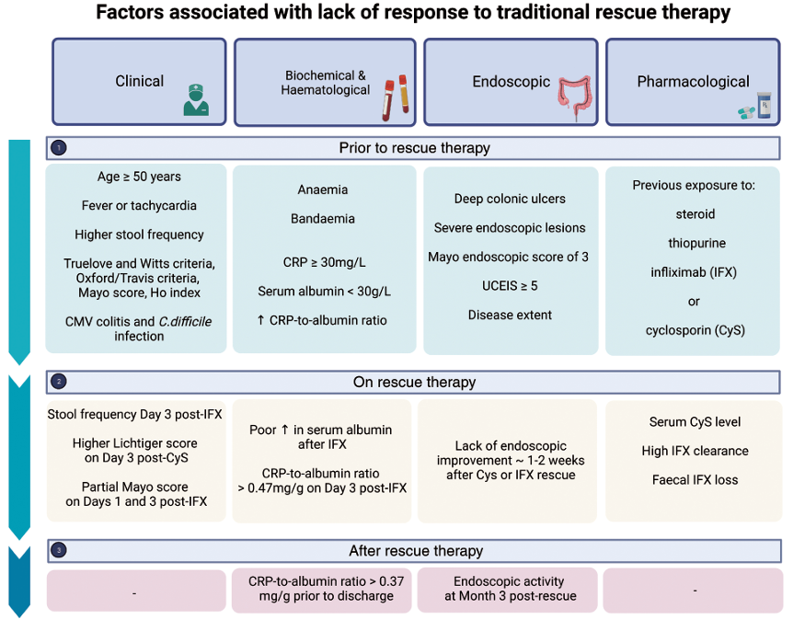
Sequential therapy
Sequential therapy refers to the use of a second rescue agent after failure of a first rescue agent
Anti-JAK
Other mAB
IFX
Li Wai Suen CFD, Intest Res. 2024

Slide 19
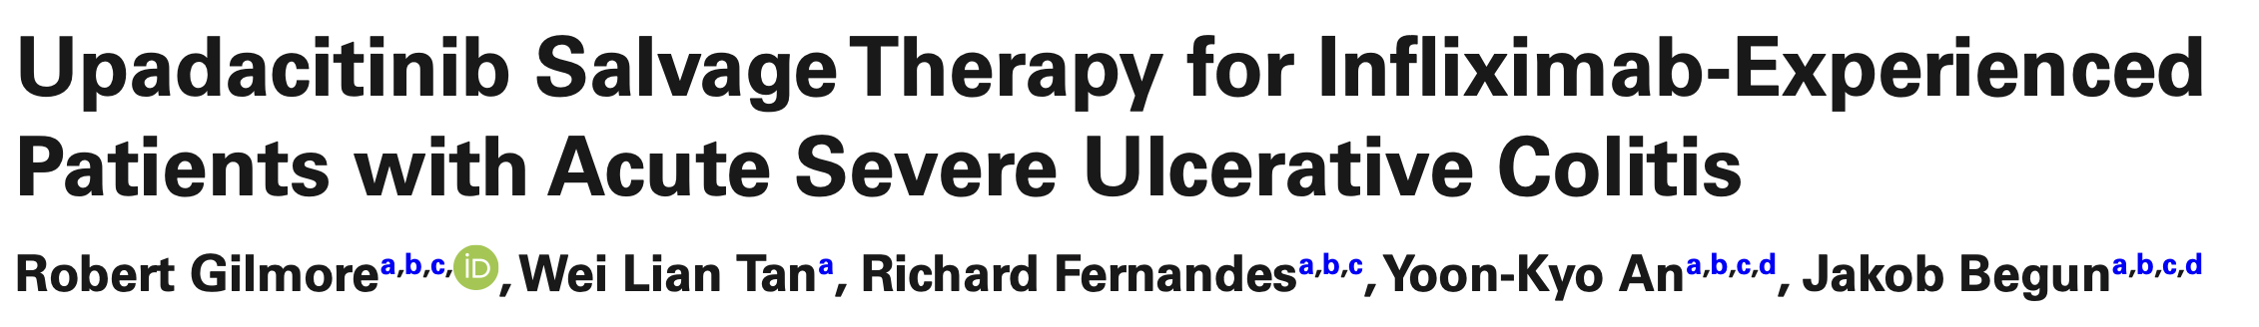
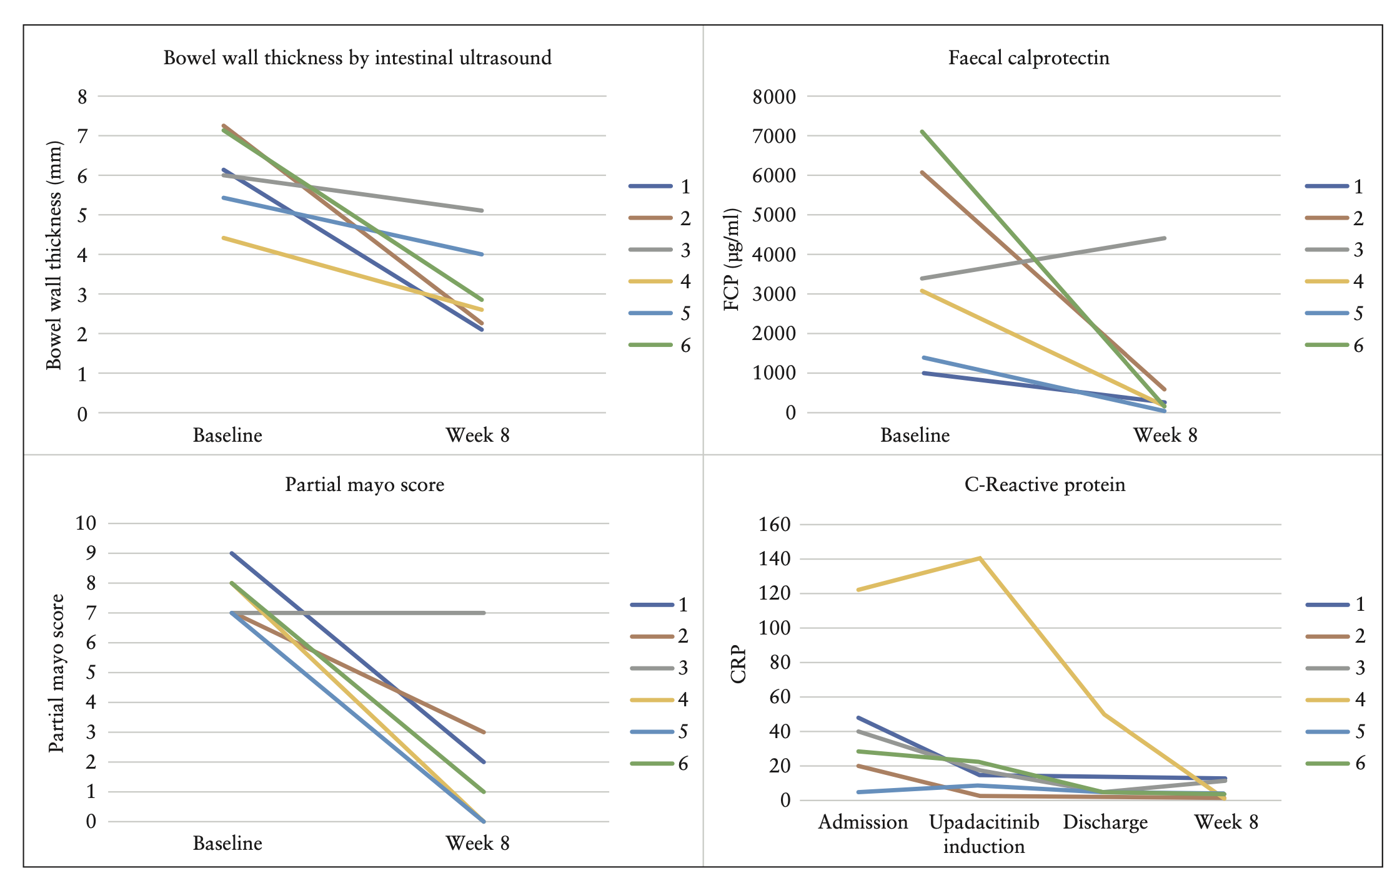
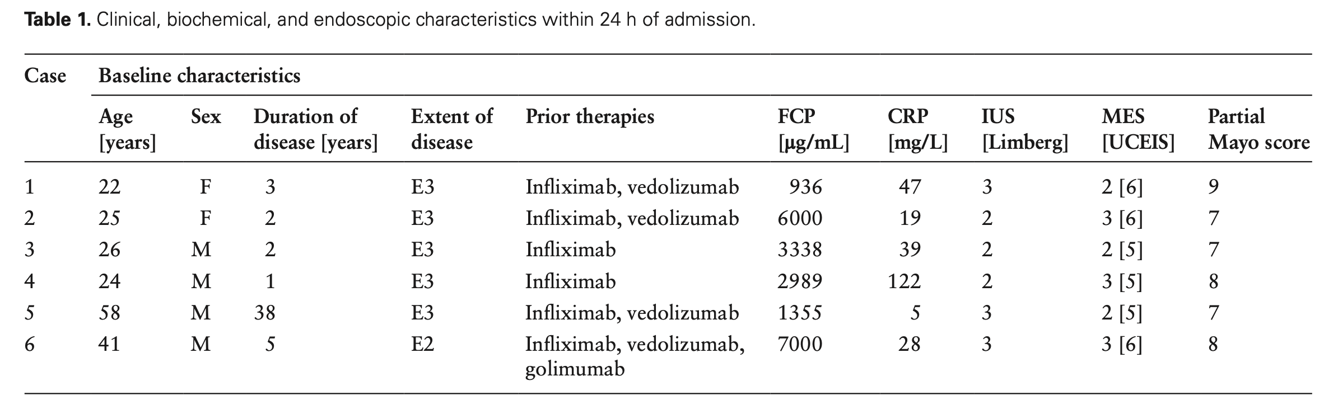
Sequential therapy: upadacitinib
Gilmore R, J Crohns Colitis 2023
Notes:
Studio australiano
Background and aims: Acute severe ulcerative colitis [ASUC] is a medical emergency treated with intravenous steroids followed by infliximab or cyclosporin in the case of steroid failure with emergent colectomy required in refractory or severe cases. Case series have reported on the effectiveness of tofacitinib for refractory disease, but data regarding the effectiveness of upadacitinib in this setting have not been previously reported. We describe the use of upadacitinib therapy for steroid-refractory ASUC in patients with prior loss of response to infliximab.
Methods: Six patients who received upadacitinib for steroid-refractory ASUC were identified at two Australian tertiary inflammatory bowel disease centres. Patients were followed for up to 16 weeks after discharge with clinical, biochemical and intestinal ultrasound [IUS] outcomes.
Results: All six patients demonstrated clinical response to upadacitinib induction during their inpatient admission. Four patients achieved corticosteroid-free clinical remission by week 8, including complete resolution of rectal bleeding and transmural healing assessed by IUS, and sustained clinical remission at week 16. One patient proceeded to colectomy at week 15 due to refractory disease. No adverse events directly attributable to upadacitinib were identified.
Conclusions: Upadacitinib may have a role as a safe and effective salvage therapy for steroid-refractory ASUC in patients who have previously failed to respond to infliximab therapy. Prospective studies are required to determine the safety and efficacy of upadacitinib use in this setting before routine use can be recommended.

Slide 20
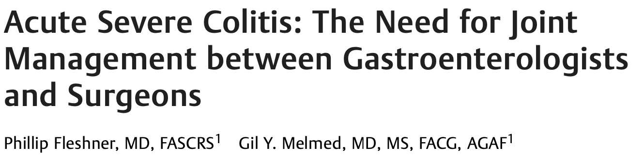
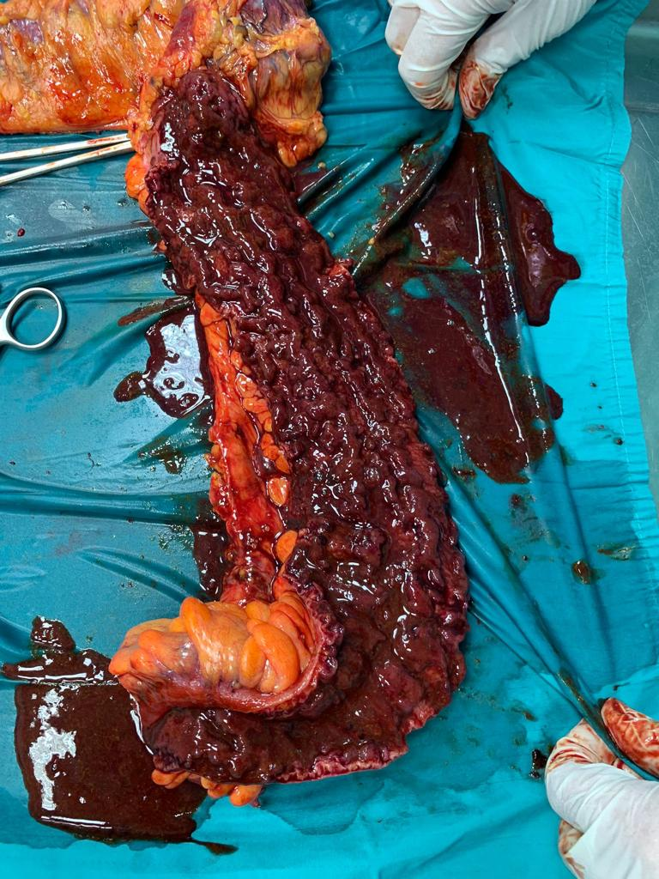
Acute severe complicated UC
Colonic perforation
Severe haemorrhage
Acute severe refractory UC
Toxic megacolon
Moran GW, Gut. 2025
Fleshner P, Clin Colon Rectal Surg 2022

Slide 21
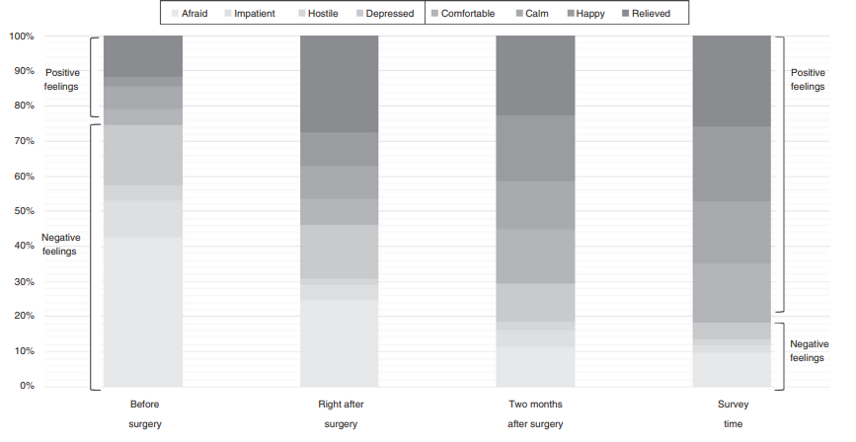

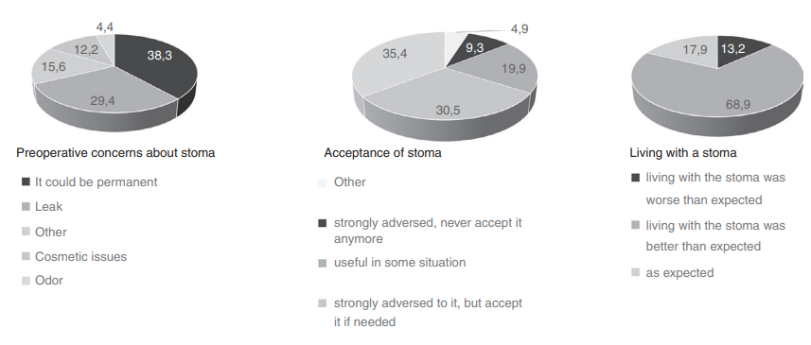
Timing&Timework: The surgeon is neither the bad one nor the ugly one
Despite the negative perception of surgery patients experienced positive outcomes from surgery, including improvement QoL and stoma acceptance
Spinelli A, Colorectal Dis. 2021

Slide 22
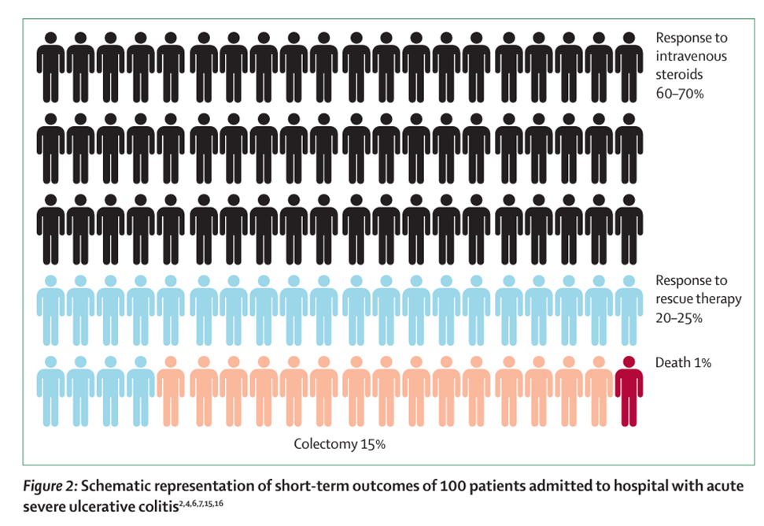
High burden of concerns in “difficult patient” setting
Riviere P, Lancet Gastroenterol Hep 2024

Slide 23
Take home messages
Joint gastroenterologist with surgeon (from the first day!)
Save the life – not the colon!
Wait and early re-evaluate to improve decisional process
Remember thromboprophylaxis and nutritional management
Clear multi-directional communication with other specialists
Rule out the infections

Slide 24
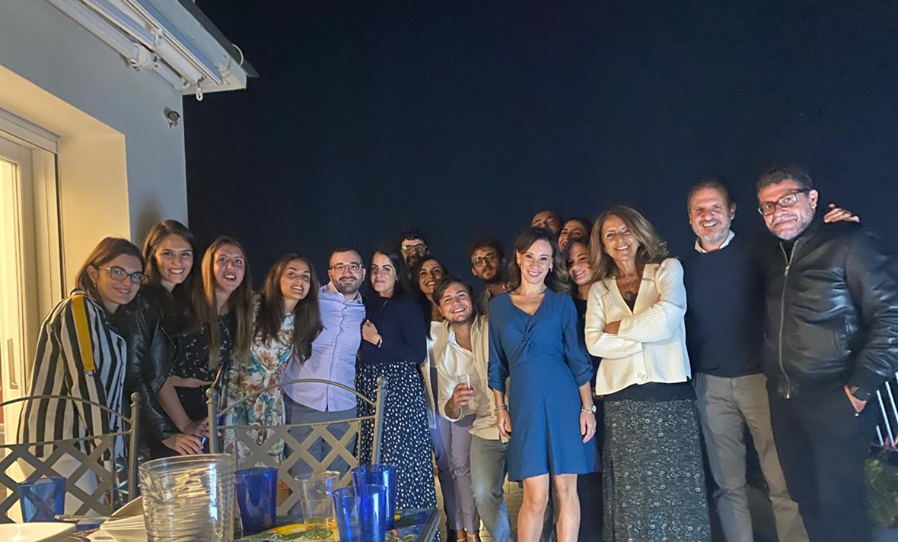
….the team……not at work!!

